Slide 1
MFG^{x} SUMMIT
24 May 2024

Slide 2
Agenda
9:00-9:30: Opening Remarks and State of the Association
9:30-10:30: Legislative Advocacy Panel Discussion
Mike Saxl, Sara Vanderwood – Maine Street Solutions
10:30-11:00: Break and Networking
11:00-12:15: Energy Panel Discussion
Mike Cloutier & Sabin Rossi – Constellation, Jesse Remillard – Efficiency Maine,
Mike Belanger – Texas Instruments, Robert Sullivan – US Dept. of Energy
12:15-12:30: Awards and Closing Remarks
MFPA – Pine Tree Award
Manufacturer of the Year
12:30-1:30: Lunch and Networking

Slide 3

WELCOME
Mike Roughton – Executive Director
Performance metrics:
Membership growth +12%
Industry/Affiliate Mix 79%/21%
ME county penetration 88%
Scholarship award increase +434%
Advocacy effectiveness +43%

Slide 4

Milestones
Introduced and successfully passed LD 1891*
Completed development of strategic plan with MAME BOD
Increased membership - 12% increase Y/Y
Moved physical offices to Augusta – now collocated w/ Maine MEP
Collaborated with Maine entities in pursuit of funding opportunities
  with DECD for the development of Quality Internships
  with MCA and MSGC for QMS and I5.0 training
  with UMaine and Roux for I5.0 assessment and deployment for the TechHub initiative
  with DOL for apprenticeships and attendant training for E&I and industrial technician roles in support of I5.0 migration

Slide 5
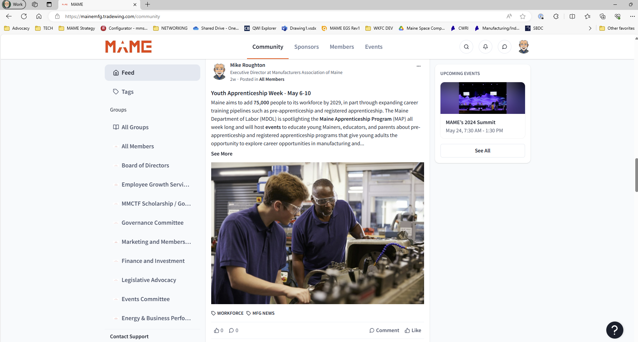
MAME Community
www.mainemfg.org

Slide 6
MAME Community
www.mainemfg.org
On-demand information vs. “push”
Private communication on topics of importance – e.g. advocacy positions
Opportunity for secure peer-to-peer communication
Home for all committee activity (incl. meeting notes, charter details, members, etc.)

Slide 7
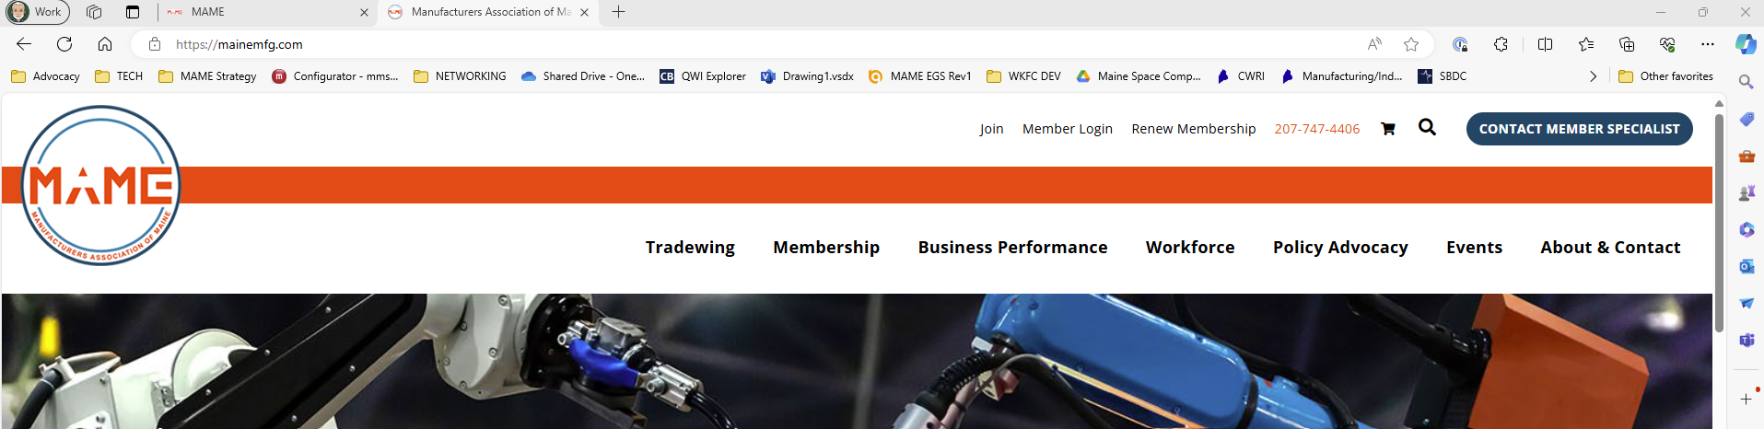
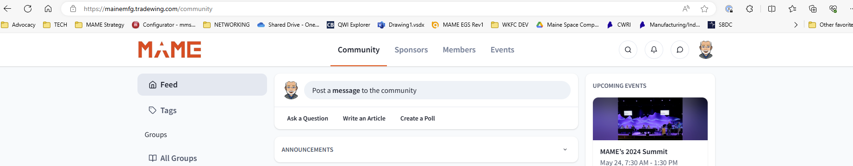
MAME Community
www.mainemfg.com
OR
www.mainemfg.org

Slide 8
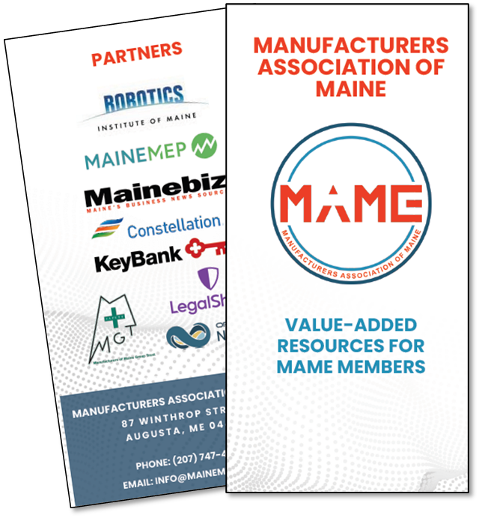
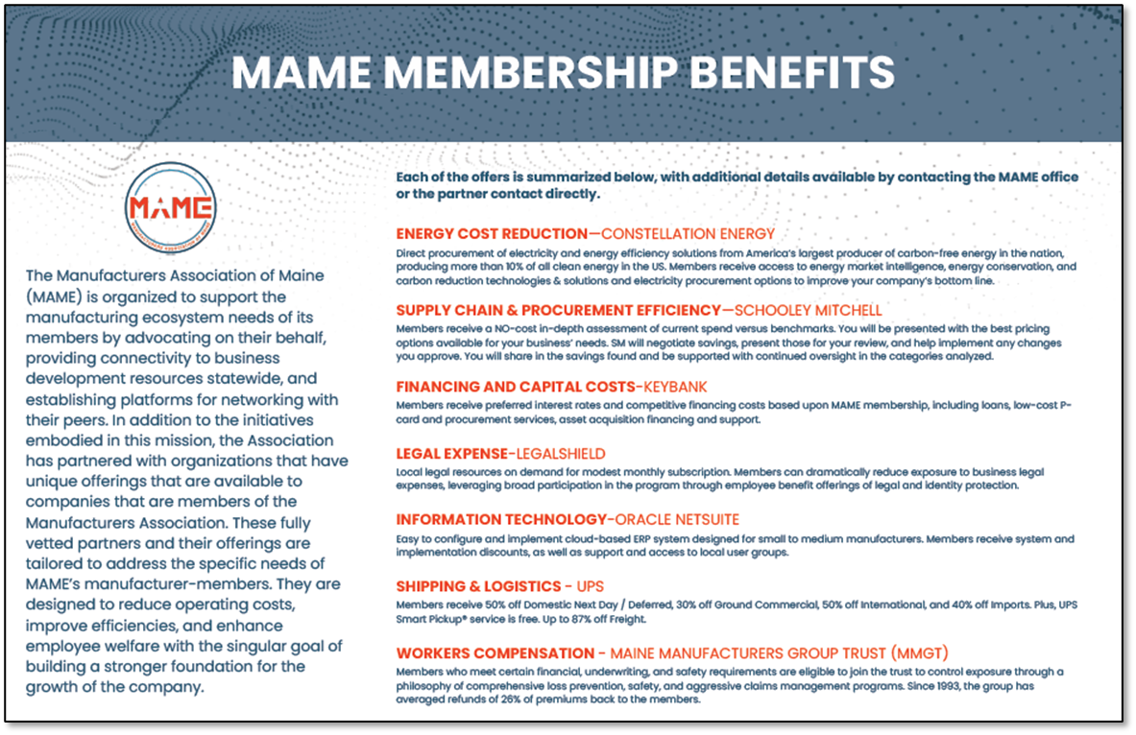
New Collateral

Slide 9

Calling out some folks in attendance. . .
Derek Fox – Elmet Technologies (Vice Chair of the MAME BOD)
Joe Rizzo – USN TPP program
Dick Dyer, John Lewis and Rachel Knight – EGS Core Team
The Maine FIRST and VEX Robotics teams. . .from Falmouth, Gorham, Oakland and Yarmouth, as well as the Coliseum here in Portland. . . all sponsored by the Robotics Institute of Maine (RIM)

Slide 10
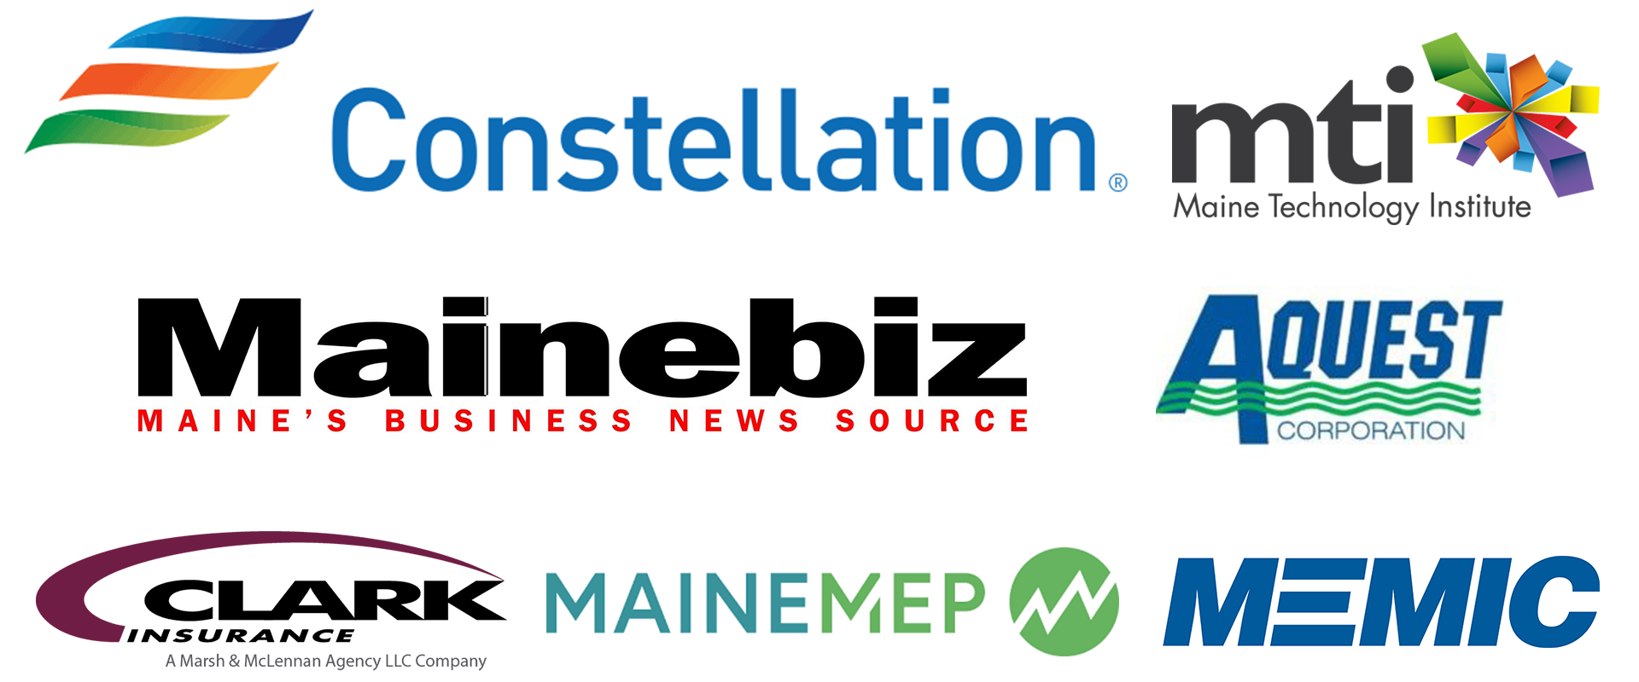
Thank-you to our sponsors

Slide 11

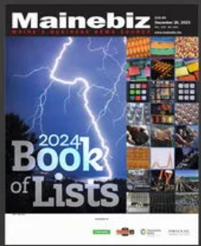
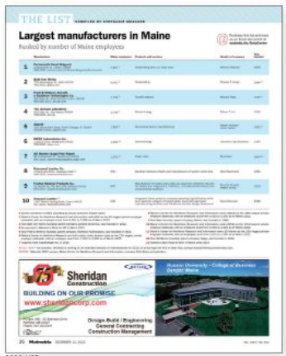
Mainebiz

Slide 12

Advocacy
A summary of activities in the 131st Session of the legislature
Maine Street Solutions - Michael Saxl, Sara Vanderwood, and Peter Gore

Slide 13
131st Legislature Overview
Education/
workforce development
Taxation
Employment & regulation/
healthcare
Energy and environmental
MSS identified and tracked 73 bills of interest
MSS and MAME directly engaged either through testimony, lobbying efforts or veto requests on 28 bills
Created and facilitated the R&D caucus of which MAME was an active participant
MAME’s Advocacy FOCUS

Slide 14

Legislative Successes
Bills SUPPORTED by MAME
LD 1891: Resolve, to Require the Office of Tax Policy to Study the Adoption of a Pass-through Entity Income Tax
  Sponsored by Rep. Mo Terry
  Enacted
LD 1537: An Act to Amend the Laws Relating to the Prevention of Perfluoroalkyl and Polyfluoroalkyl Substances Pollution
  Sponsored by Senator Henry Ingwersen
  Enacted
LD 416: An Act to Authorize a General Fund Bond Issue for Research and Development and Commercialization
  Sponsored by Sen. Teresa Pierce
  Enacted-requires voter approval

Slide 15
Legislative Successes
Bills OPPOSED by MAME
LD 1977: An Act to Enact the Maine Data Privacy and Protection Act
  Sponsored by: Rep. Maggie O’Neil
  Defeated
LD 1496: An Act to Restrict Noncompete Clauses
  Sponsored by Rep. Sophie Warren
  Vetoed
LD 1231: An Act to Bring Fairness in Income Taxes to Maine Families by Adjusting the Tax Brackets
  Sponsored by Rep. Mickey Carmichael
  Vetoed

Slide 16
Saved by Dysfunction
Bills OPPOSED by MAME
Labor Bills
  LD 513, An Act Regarding Overtime Protections for Certain Salaried Employees
  LD 741, An Act to Prohibit Certain Training Repayment Agreements by Employers
  LD 827, An Act to Allow Employees to Request Flexible Work Schedules
  LD 936, An Act to Require Employers to Disclose Pay Ranges and Maintain Records of Employees' Pay History
  LD 949, An Act to Protect Workers from Employer Surveillance
  LD 1190, An Act to Require Minimum Pay for Reporting to Work
Health Insurance Mandates
  LD 132, An Act to Require Health Insurance Carriers to Provide Coverage for Blood Testing for Perfluoroalkyl and Polyfluoroalkyl Substances
  LD 444, An Act to Require Health Insurance Coverage for Specialized Risk Screening for First Responders and Other Public Safety Professionals
  LD 1577, An Act to Require Health Insurance Coverage for Biomarker Testing
  LD 2203, An Act to Require Health Insurance Coverage for Federally Approved Nonprescription Oral Hormonal Contraceptives and Nonprescription Emergency Contraceptives

Slide 17

Looking to the Future
Continue work on Pass Thru Entity Tax legislation to give our members relief from federal income tax.
Expand access to quality, affordable childcare to attract more people into the workforce.
Actively promote changes to legislative rules that reduce complexity, foster deeper understanding of issues, and generally improve the efficiency of the process
Expand relationships with new and returning legislators to build champions through establishment of a legislative Workforce Caucus to build coalitions to support expansion of workforce and housing initiatives.
Defeat anti-employer legislation which are sure to resurface in 2025 such as: privacy, business tax increases, non-compete clauses, employer surveillance, and increased mandates on health insurance.

Slide 18
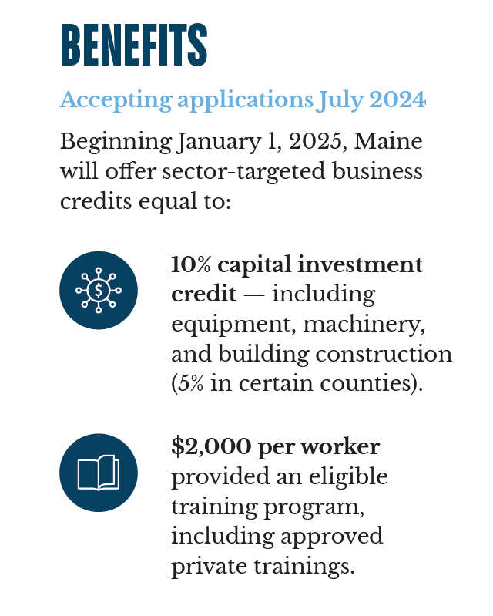
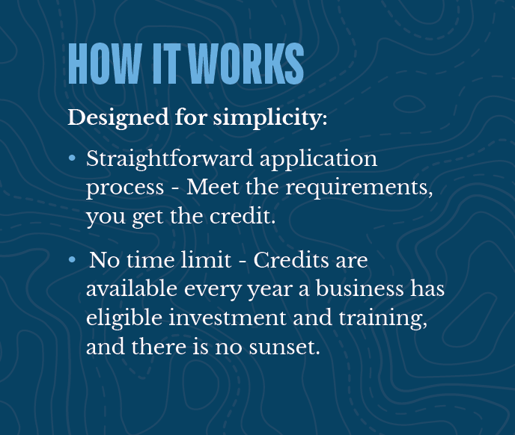

Dirigo Business Incentives
LIMITS: Credit capped at $2 million per business per year, can be taken over 5 years. Up to $500,000 of the credit would be refundable per year.
Email: DECDTaxIncentives@maine.gov

Slide 19
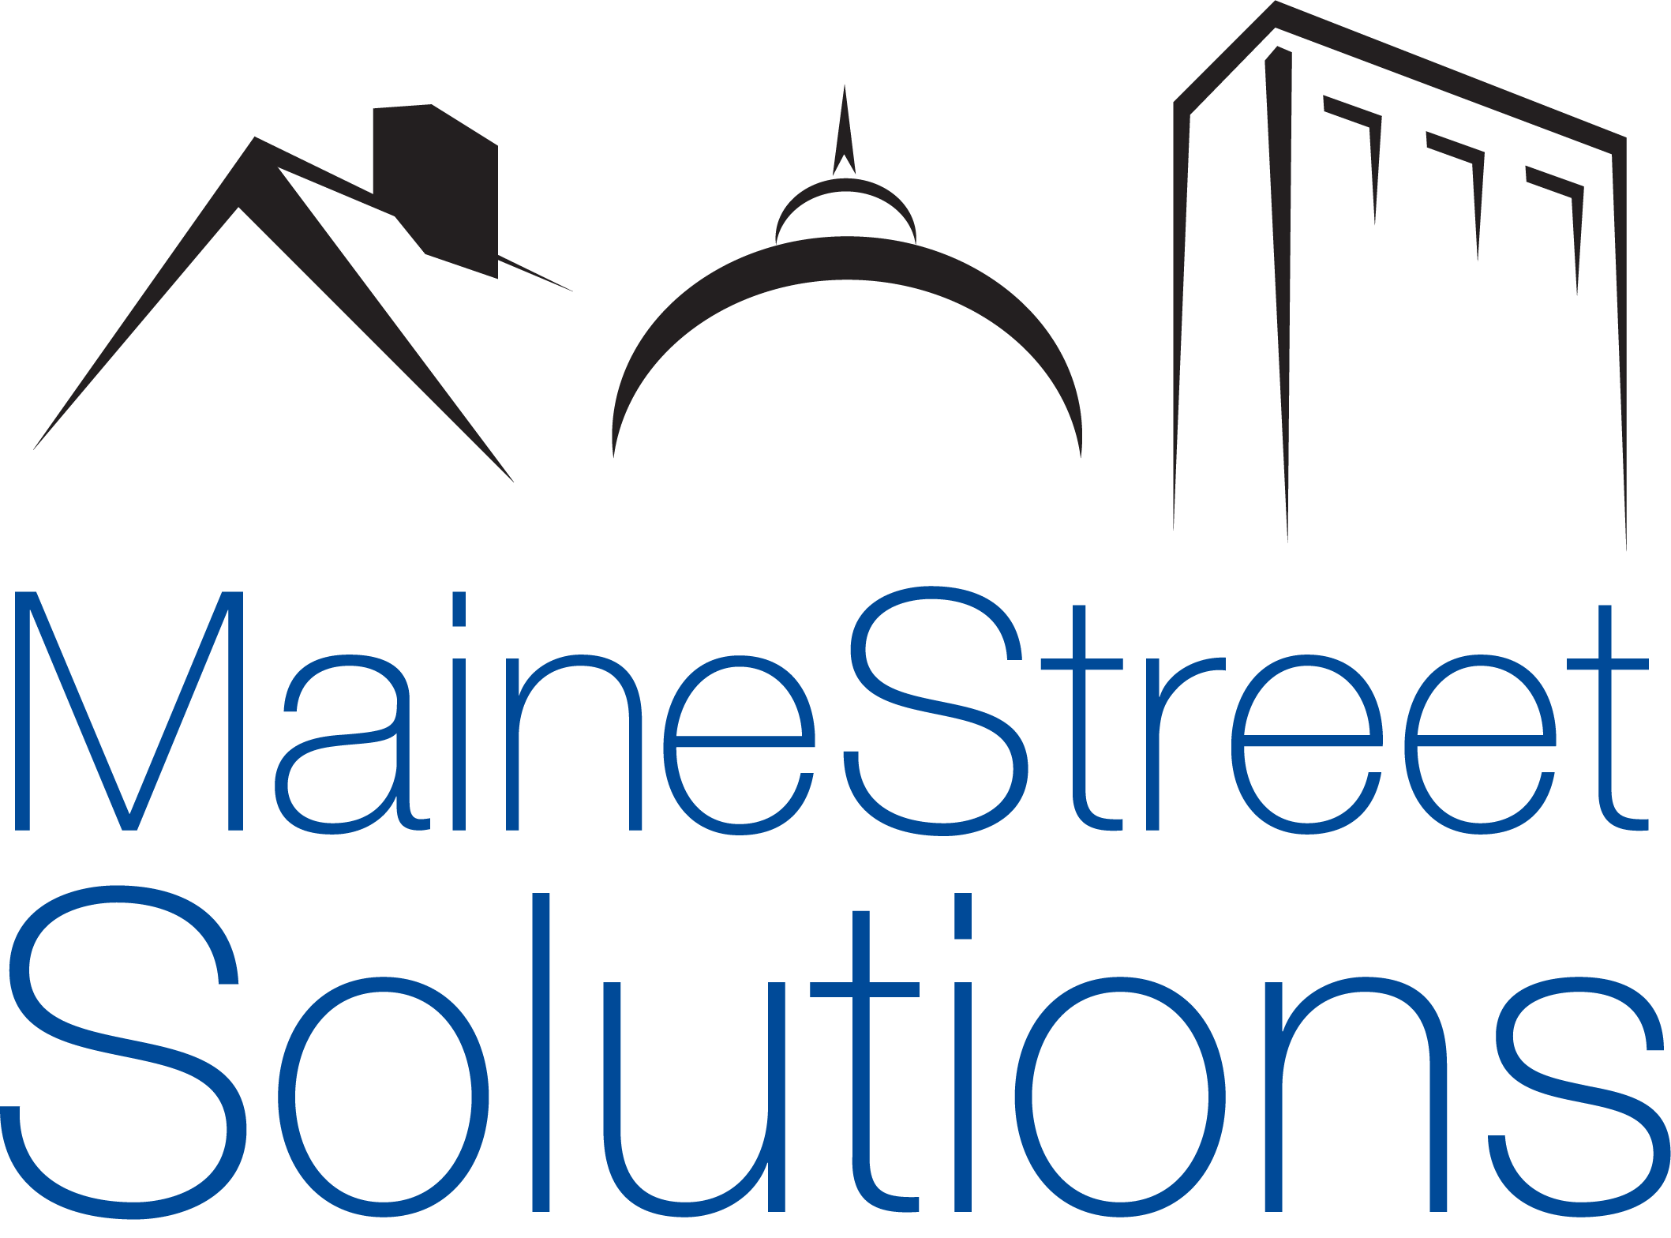
THANK YOU!
Please let us know how we can help:
Michael Saxl (207) 329-7159
Sara Vanderwood (207) 485-4945

Slide 20
Panel Dialogue
Moderator: Mike Saxl – Maine Street Solutions

Slide 21

NETWORKING
BREAK

Slide 22

Energy
Constellation, Efficiency Maine (incl. Texas Instruments) and the Department of Energy

Slide 23

Constellation
Mike Cloutier

Slide 24
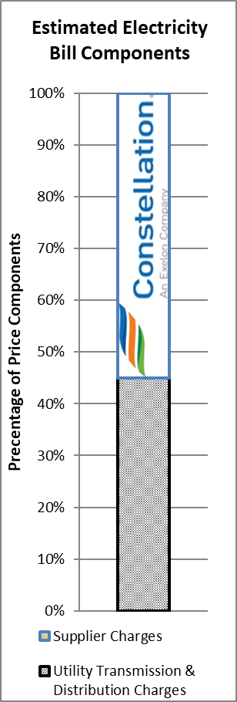
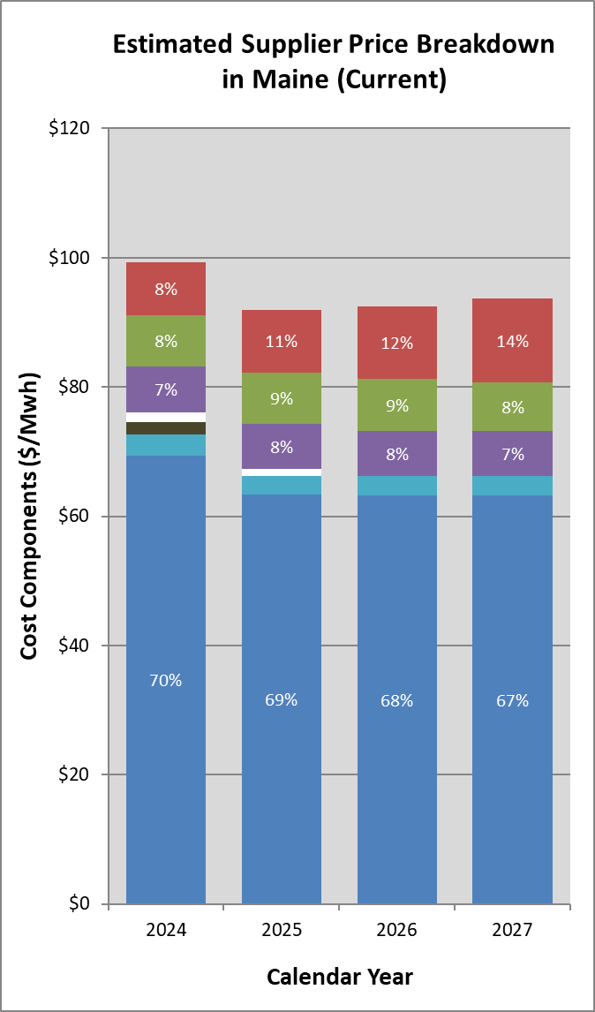

What’s In Your Electric Supplier’s Price?
Capacity – Determined by prices set from independent system operator (ISO)-run auctions and customer capacity tag (peak usage). Designed to provide grid reliability and ensure enough generation available to the region.
Renewable Portfolio Standards (RPS) – Mandates set by individual states for load-serving entities (LSE’s/Constellation) to purchase a certain amount of renewable energy. Determined by state regulated compliance percentages and the financial market for renewable energy certificates (RECs).
Cost of Service/Fuel Security Ch. 1 – Additional costs to LSE’s to fund out-of-market compensation for particular resources to ensure grid reliability in the region.
Inventoried Energy Program/Fuel Security Ch. 2 – ISO New England administered program that will provide payments to resources that can store fuel for winters ‘23/24 & ‘24/25.
Ancillaries – Small administrative charges billed to load-serving entities by the ISO to operate grid safely and reliably.
Line Losses – Included to make up for the energy lost over transmission and distribution (T&D) lines due to heating
Energy – The cost of procuring the actual electrons transmitted through the T&D lines. Largely determined by cost of natural gas for New England.
* Source: Proprietary Data, Eversource
** Disclaimer: This information is provided for illustrative purpose only and should not be construed as advice regarding the purchase or sale of exchange-traded futures, options contracts, or energy commodities. This report is based, in part, upon factual information obtained from sources believed to be reliable, but the accuracy of such information is not guaranteed. Past performance is not necessarily indicative of future results. Furthermore, the forward -ooking information and analysis that may be contained in any such report may be based upon: (a) a number of viable factors and assumptions that are constantly changing and (b) our subjective judgments and opinions. Such information will be provided as of the date of any such report (with no obligation on our part to update), is subject to change, and is provided herein for informational purposes only. Reliance upon any such information and analysis in such a report for decisions is the sole risk of the purchaser.

Slide 25
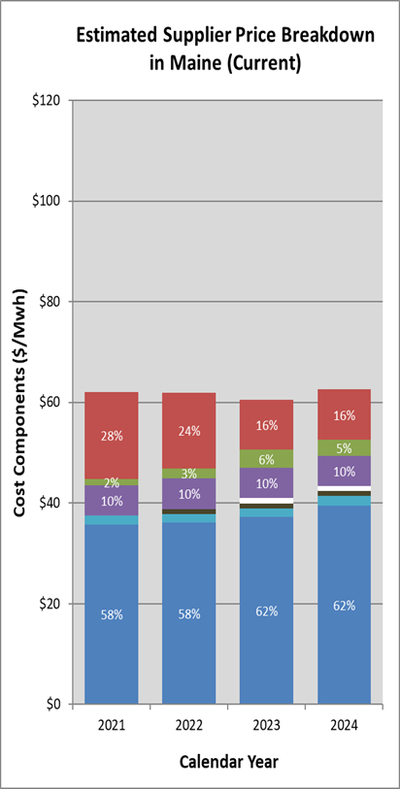
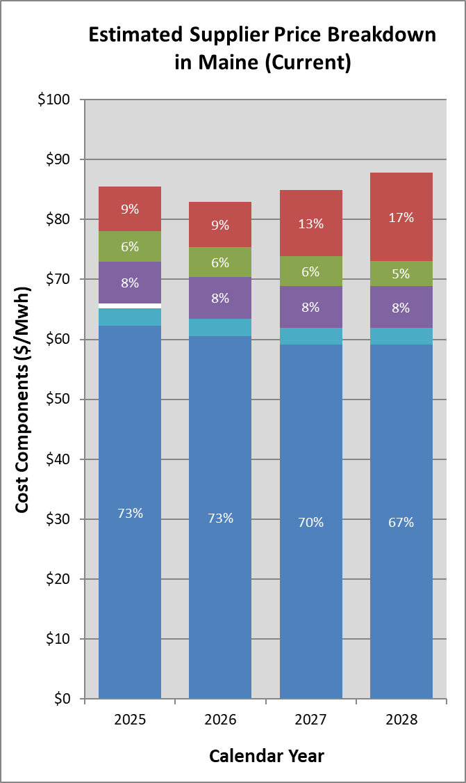
Supplier Stack 2020 vs. Today
Vs.
* Source: Proprietary Data, Central Maine Power
** Disclaimer: This information is provided for illustrative purpose only and should not be construed as advice regarding the purchase or sale of exchange-traded futures, options contracts, or energy commodities. This report is based, in part, upon factual information obtained from sources believed to be reliable, but the accuracy of such information is not guaranteed. Past performance is not necessarily indicative of future results. Furthermore, the forward -looking information and analysis that may be contained in any such report may be based upon: (a) a number of viable factors and assumptions that are constantly changing and (b) our subjective judgments and opinions. Such information will be provided as of the date of any such report (with no obligation on our part to update), is subject to change, and is provided herein for informational purposes only. Reliance upon any such information and analysis in such a report for decisions is the sole risk of the purchaser.
© 2024 Constellation. The offerings described herein are those of either Constellation NewEnergy, Inc. or Constellation NewEnergy-Gas Division, LLC, affiliates of each other. Brand names and product names are trademarks or service marks of their respective holders. All rights reserved.

Slide 26
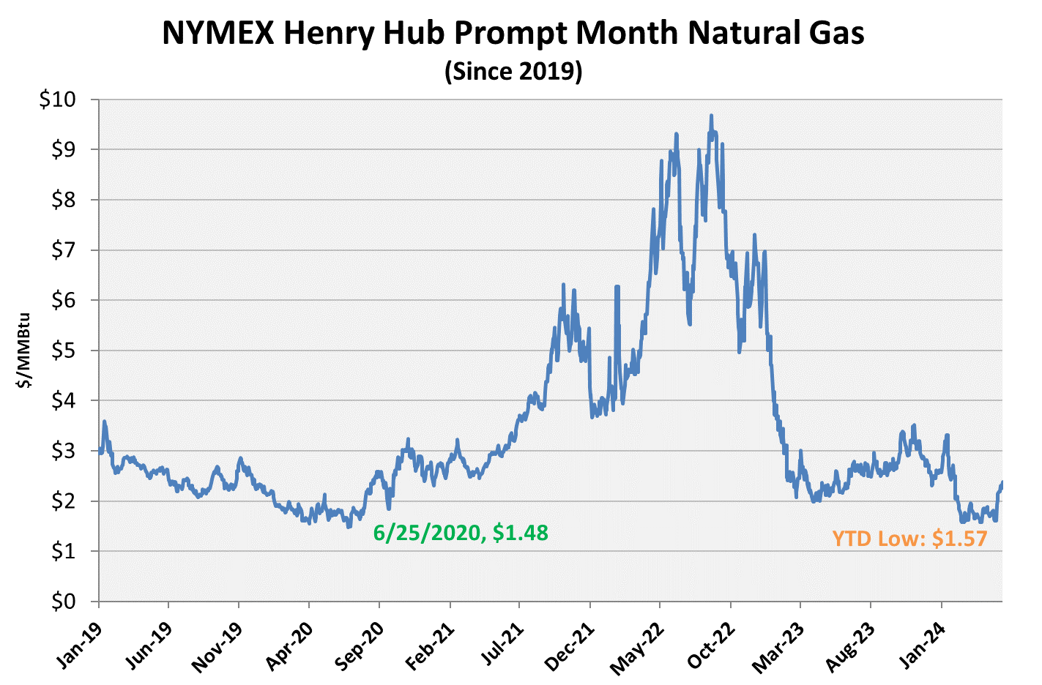
Nat Gas Prices Up
From 3.5-Year Low in Q1, Still Near Historic Lows
Customer Takeaway: The warmest winter on record yielded historically high gas inventories which pushed prompt-month prices to their lowest since June 2020. Since then production has pulled back, a warm summer has been forecasted, and the hot-button topic of data centers/load growth has emerged pushing prices higher but still near $2/MMBtu.

Slide 27
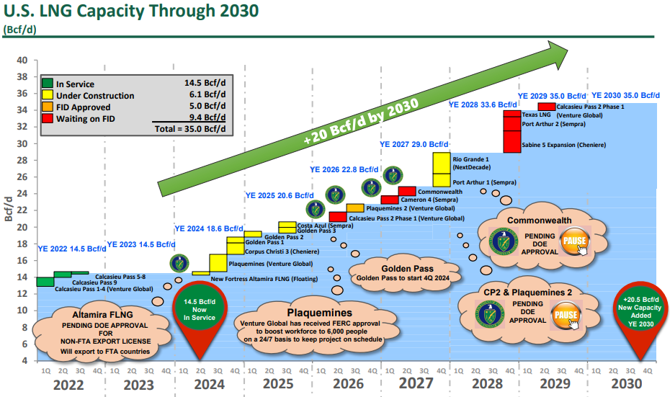
US LNG Export Growth Will Lead the Way for Natural Gas
Sources: Antero Resources

Slide 28
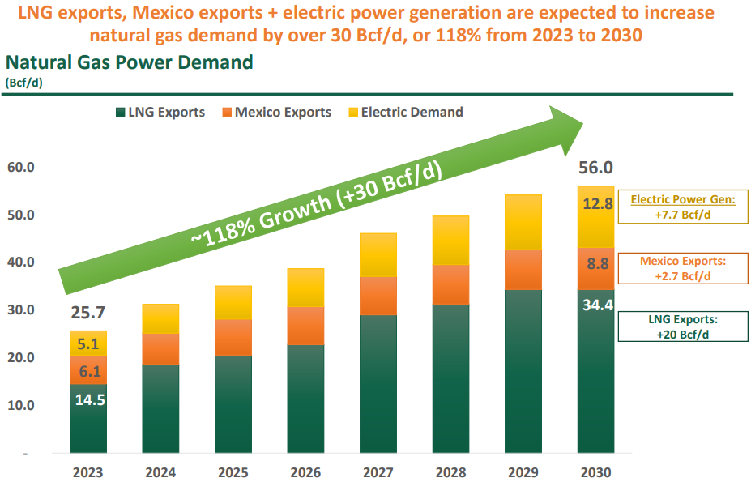
Market Bullish on Natural Gas Demand
Sources: Antero Resources, Range Resources

Slide 29
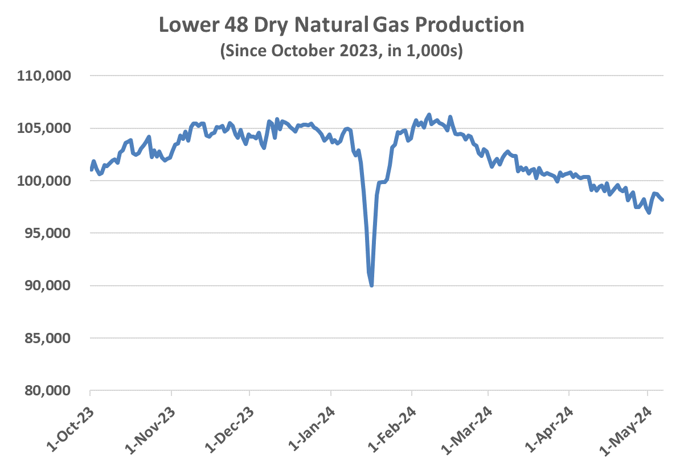
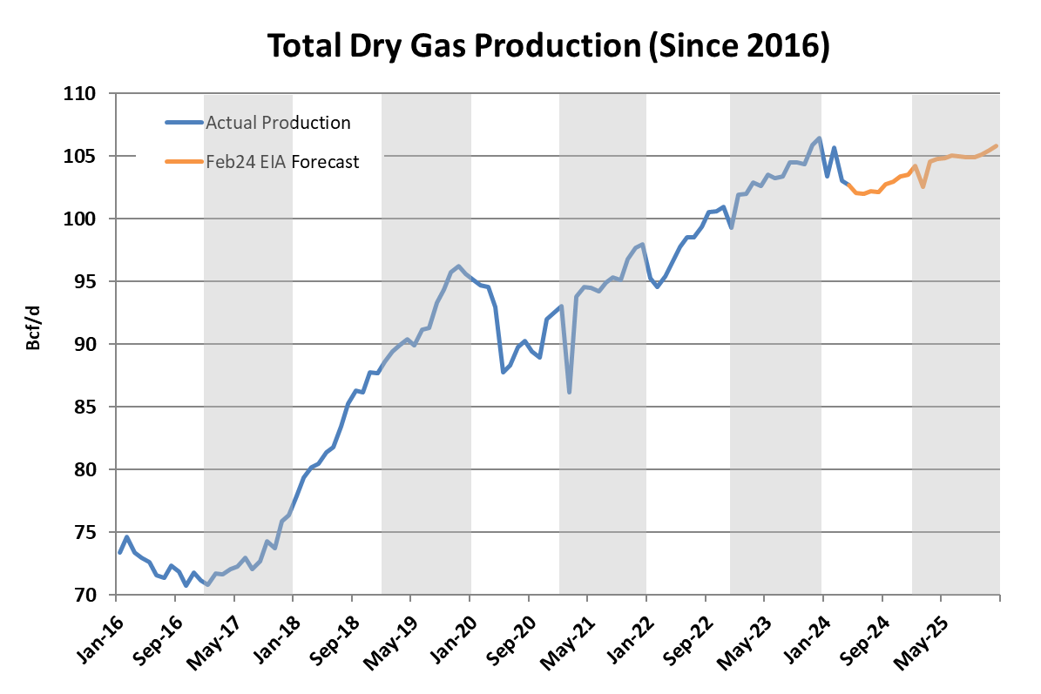
Producers Stick to 2024 Game Plan, Pullback While Prices Low
Customer Takeaway: Producers have executed and reinforced the planned production cuts announced February. Additional decreases stem from spring pipeline maintenance which could be flushed out in June. Either way, levels below 100 Bcf/d should continue to put upward pressure on prices, especially further out the curve.
Chesapeake curtailed over 0.2 Bcf/d in Q1 and plans for 0.4 Bcf/d in Q2.
EQT revised down full-year production guidance by 0.1 Bcf/d after pulling back 1 Bcf/d of production since February and plans to extend through May.
Range Resources announces the shift of their dry gas offline wells to even later in the year, while maintaining their flat annual production target.

Slide 30
Pricing
Constellation

Slide 31
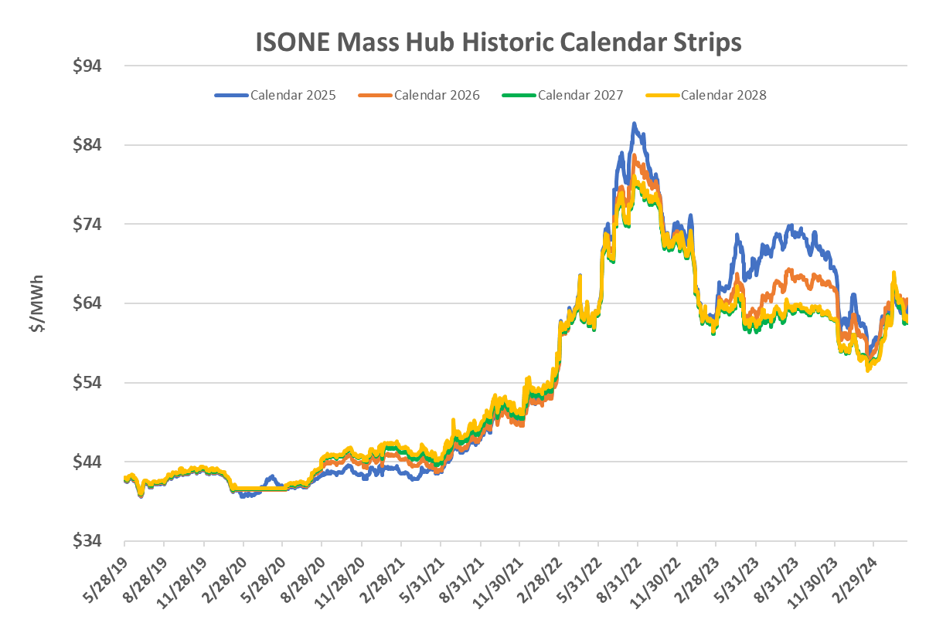
New England Historical Power Pricing – 5 Year Lookback
5-year LOOKBACK
Sources: Constellation

Slide 32
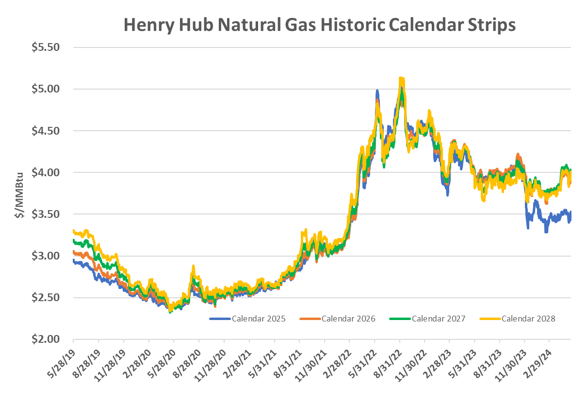
Natural Gas Calendar Strips
Also Elevated vs. 2020/21
Source: Constellation

Slide 33
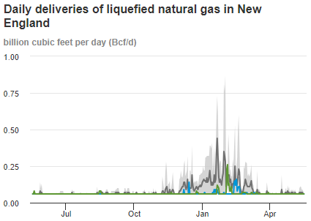
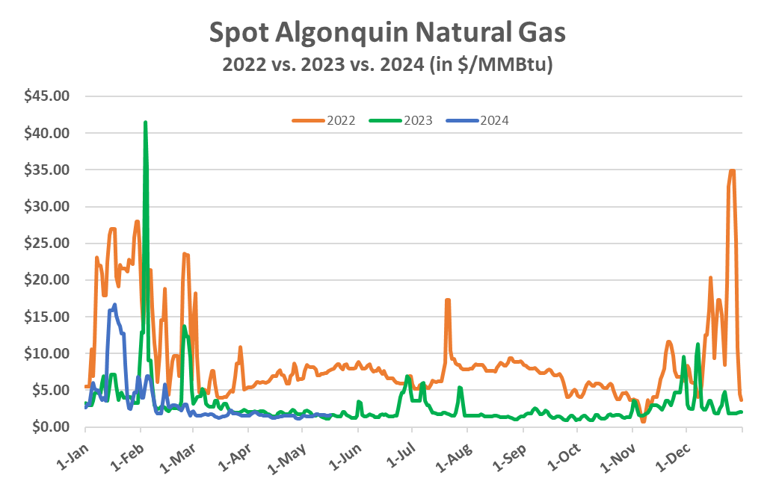

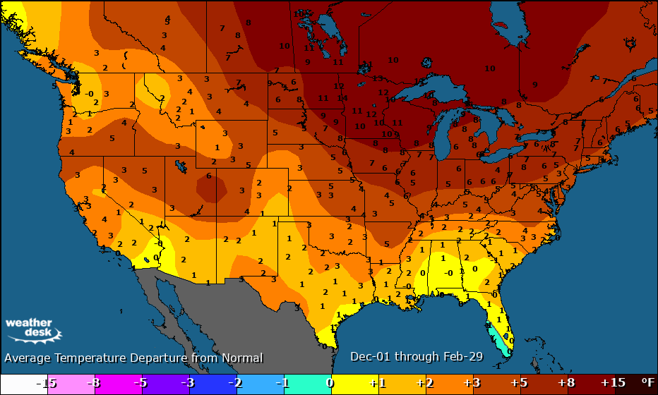
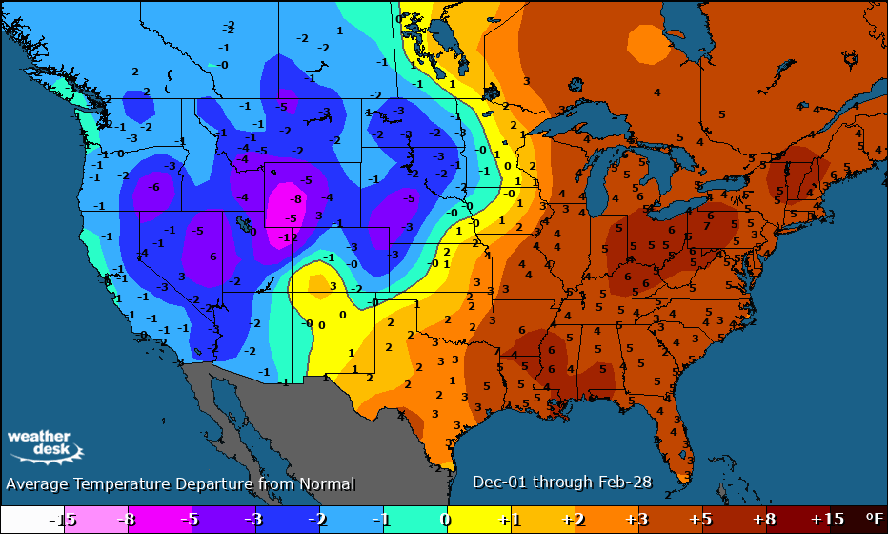
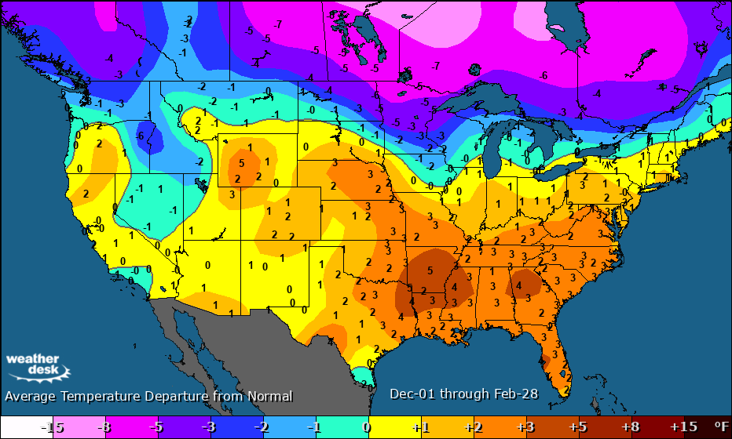
Uniqueness of New England Energy – Elevated Winter Risks
New England Winter Rankings (out of 74 yrs)
Sources: Constellation, Maxar
Winter 23/24 (5th warmest NE, 1st nationally)
Winter 22/23 (4th & 6th warmest)
Winter 21/22 (22nd and 17th)

Slide 34
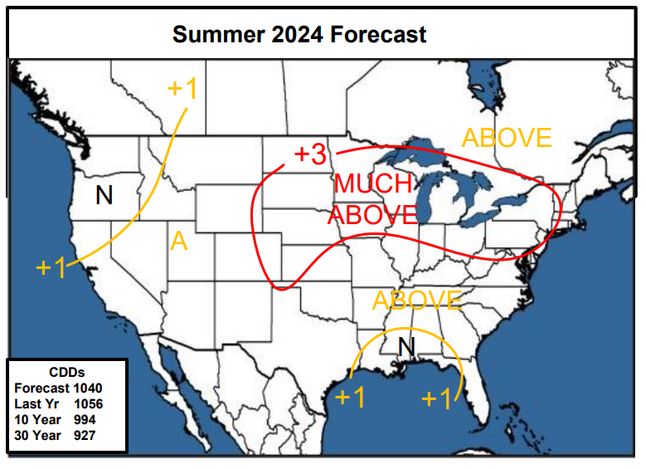
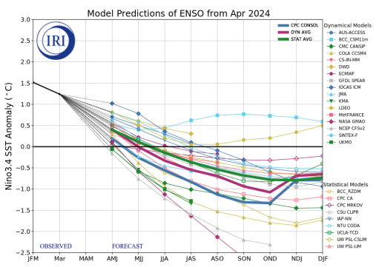
“Top 5” Summer Heat Expected
Constellation Summer Forecast Headlines
  5th warmest on record expected – 1,040 population-weighted cooling degree days (CDD)
    Last year: 978 (5th warmest)
    10-Year Normal: 994 (9th warmest)
    30-Year Normal: 927
    Third Parties: 1,010 - 1,030 (5-10th warmest)
Overall forecast confidence is higher than usual this summer, stemming from a combination of a fading El Nino, drought levels and well matching analog years.
Our national forecast of 1040 PWCDD’s is slightly hotter than the market and is
inside the top 5 for the first time since 2022.
Customer Takeaway: The trend of warm summers should continue this summer. With storage inventories at 8-year highs, it likely would take an absolute scorcher to really push the market substantially higher, all other things equal.
Source: Constellation, NOAA
Notes:
The lowest confidence is in the West where some cooler signals are present, though a below-normal summer hasn’t happened in 10 years.

Slide 35
Key New England Strategic Takeaways
Short-Term
Domestic/Henry Hub prompt month natural gas prices have moved above $2/MMBtu as elevated seasonal cooling demand in June distances prices from the Q1 floor of $1.60.
Underground storage began injection season with a rolling start from the warmest winter on record and some LNG export terminal disruptions (Freeport LNG) - now positioned 33% over the 5-year average.
A rash of public producer news points to tempered spending and output in 2024 as recent production has dropped 5-6 Bcf/d from Februarys YTD high with spring maintenance also contributing.
Global markets look well supplied despite an abundance of geopolitical risks as European storage has benefited from a warm winter now 33% above the 5-year average – prompt month prices trade at $8 - 10/MMBtu.
  Link to New England energy prices still exists because of winter LNG imports into the region.
The Constellation Weather Desk is highly confident in their forecast of a top 5 warmest summer as the strong El Nino we saw over the winter transitions to neutral and eventually a La Nina this fall.
  An upcoming La Nina winter could mean significantly more colder signals that what we saw this past winter
Medium- and Long-Term
Many are now forecasting much more significant forward natural gas demand for power generation as the data center/load growth boom peaks in several years on top of LNG export growth. Can production keep pace???
Significant clean power supply resources (wind & hydro/transmission) are still expected to come online in the region over the next 5 years which is likely contributing to the flatness across the New England energy curve.
  Like all other energy regions, will still need fossil fuel resources for reliability

Slide 36



#1 producer of carbon-free 24/7 energy in the United States
Lowest carbon emissions and carbon intensity generator in the United States
Largest nuclear operator in the United States
32,400 MWs of total generating capacity
~124 million metric tons of carbon avoided through our fleet
94.5% capacity factor at nuclear plants
Ability to extend fleet to 80 years – providing 24/7 carbon-free power through 2050 and beyond
Approximately 13,000 employees nationwide
Investing in local communities through $215 million in local property taxes and $93 million in state payroll taxes
Employees volunteered nearly 64,800 hours in 2021
Increasingly diverse workforce, with strong diverse hiring and promotion rates and community workforce development partnerships
#1 in market share for C&I customers
#2 retail electricity provider
#3 in market share for mass market customers
Top 10 natural gas provider in the United States
Serve ¾ of the Fortune 100
2 million residential, public sector and business customers
205 TWhs of load served
Operate in 48 states and the District of Columbia
© 2023 Constellation Energy Resources, LLC. The offerings described herein are those of either Constellation NewEnergy, Inc. or Constellation NewEnergy-Gas Division, LLC, affiliates of each other. Brand names and product names are trademarks or service marks of their respective holders. All rights reserved. Errors and omissions excepted.

Slide 37

Constellation: By the Numbers
Constellation is the
#1 zero-carbon energy
producer in the U.S with nearly 90% carbon-free output, backed by more than
32,000 MW
of generating capacity.
13,000
Employees
Scalable national
platform of over
2 million
residential, public sector
and business customers
served, offering
a diversity of
innovative products
and services, including
¾ of Fortune 100 companies
Power Supply Mix
Nuclear
Conventional
Owned Renewable
Contracted Renewable
Purchased Power
TWh
176
20
7
7
73
Operates in
48 States & DC
Goal of Providing
100%
of business customers
with custom GHG data
by end of 2022
205 TWh
1.6 Tcf
Customer Load Served
C&I
Market Share Ranking
#1
© 2023 Constellation Energy Resources, LLC. The offerings described herein are those of either Constellation NewEnergy, Inc. or Constellation NewEnergy-Gas Division, LLC, affiliates of each other. Brand names and product names are trademarks or service marks of their respective holders. All rights reserved. Errors and omissions excepted.

Slide 38
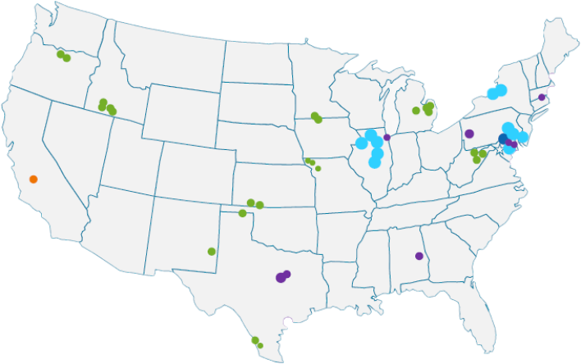
Generating Assets
Constellation produces around 10% of the nation’s carbon-free energy
Constellation Owned Assets
Nuclear
Wind
Gas/Other
Solar
Hydro
Other Renewables
© 2023 Constellation Energy Resources, LLC. The offerings described herein are those of either Constellation NewEnergy, Inc. or Constellation NewEnergy-Gas Division, LLC, affiliates of each other. Brand names and product names are trademarks or service marks of their respective holders. All rights reserved. Errors and omissions excepted.

Slide 39
Power Procurement Options
Constellation provides the power buying strategies and tools that you need to manage your budget, risk tolerance and needs of your facility over time.
Risk
100% Fixed or Secured Price*
Blended Strategies
100% Index Price
Procurement Strategy
Mostly Fixed, Partially Index
Mostly Index, Partially Fixed
Equal Blend
*Please inquire to see which is available in your region.
© 2023 Constellation Energy Resources, LLC. The offerings described herein are those of either Constellation NewEnergy, Inc. or Constellation NewEnergy-Gas Division, LLC, affiliates of each other. Brand names and product names are trademarks or service marks of their respective holders. All rights reserved. Errors and omissions excepted.

Slide 40
Strategic Approaches to Buying Power
One size doesn’t fit all when it comes to developing a customized power purchasing strategy.
Fixed or Secured Price*
Flexible Solutions
Fixed Point-in-Time Purchasing
Regular Market Volatility
Flexible Purchasing
Regular Market Volatility
Market Price ($)
Market Price($)
Time
Time
Index + Block Solutions
It’s important to consider your unique usage profile, risk tolerance and budget goals. Your energy strategy could include a variety of products, each with their own characteristics.
Usage at Index Price
Load (KWh)
Block Purchases
Time
*Product availability varies by state and customer class
**Graphs are for illustrative purposes only; does not represent real data.
© 2023 Constellation Energy Resources, LLC. The offerings described herein are those of either Constellation NewEnergy, Inc. or Constellation NewEnergy-Gas Division, LLC, affiliates of each other. Brand names and product names are trademarks or service marks of their respective holders. All rights reserved. Errors and omissions excepted.
Notes:
Fixed Price Solutions (FPS)- A Single point-in-time strategy in which prices are fixed for all of a customer’s load for the term of the contract. A simple strategy for customers that prefer one price per kilowatt-hour (kWh) for their entire load no matter what their operations may require.
Flexible Index Solutions (FIS) – A Blended Strategy in which the customer purchases power through a combination of Fixed and Variable pricing. FlS is a blended strategy for customers that would prefer a fixed price for a load following percentage of their usage with the remainder floating on the index. Customers can chose to fix any percentage up to 100% of their load, and can reach that desired percentage over time.
Index Plus Block Solutions (IPBS) - A Blended Strategy in which the customer fixes the price for a flat fixed volume based on usage patterns, and any usage above the set fixed volume will receive index or index market pricing. IPBS is also a blended strategy for customers that have consistent operations and want to limit their exposure to the market while taking advantage of favorable market conditions

Slide 41
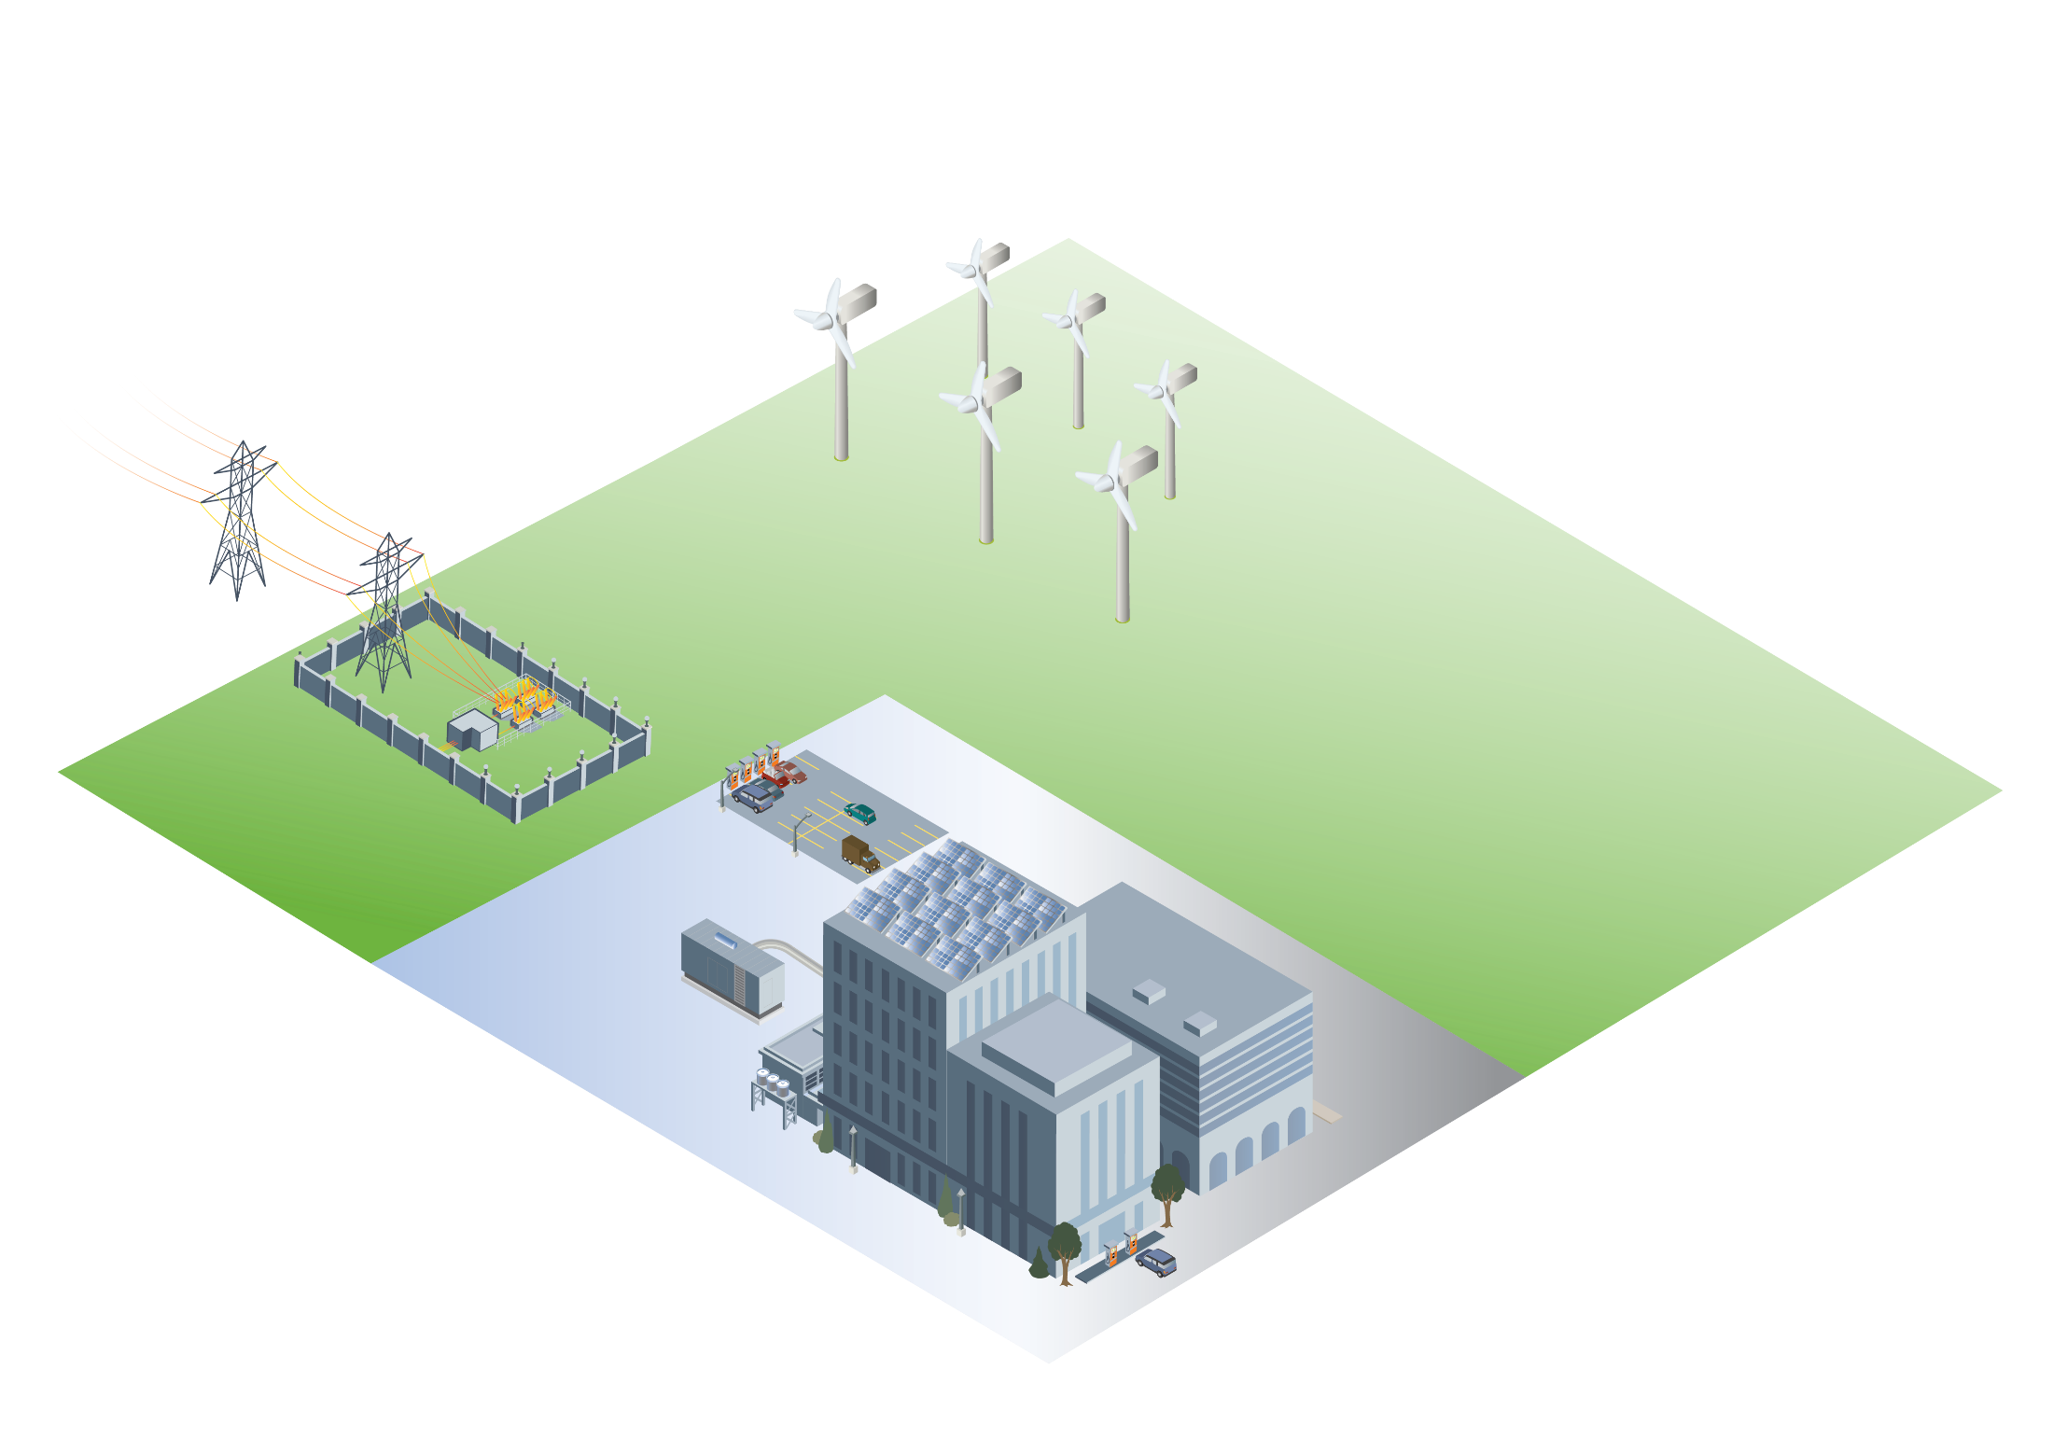
Developing a Sustainability Plan
1) Develop a custom Power and Natural Gas purchasing strategy
2) Develop a renewable energy and carbon offset strategy
3) Understand
On and off-site generation options
4) Implement energy efficiency upgrades and leverage emerging technology
5) Leverage market expertise, monitoring and reporting
© 2023 Constellation Energy Resources, LLC. The offerings described herein are those of either Constellation NewEnergy, Inc. or Constellation NewEnergy-Gas Division, LLC, affiliates of each other. Brand names and product names are trademarks or service marks of their respective holders. All rights reserved. Errors and omissions excepted.
Notes:
Modern, cutting edge, sustainable, green. These all describe your facility. Let’s explore 5 strategies that help meet those goals now, and into the future.
Commodity purchasing strategies
Smarter options in purchasing. A recent Constellation white paper explores 73 strategies in impacts on risk and price. When looking just at HOW you buy electricity, there is a $22 cost difference between strategies. Understanding how and when to buy is an important component to managing cost.
Renewables
Customer Driven Renewable Revolution. Meteoric rise in corporate demand for renewable energy, similar shifts with –
(1) Upswing in gas and power prices and volatility from 2003 and 2008 driven by global commodity demand, and made more significant in the aftermath of Hurricanes Katrina and Rita.
(2) The fracking revolution leading to an abundance of domestic gas supply that has brought pricing and volatility to historical lows.
(3) Renewable procurement – is proving equally impactful, and it’s all about, you, the consumer. The information age has increased the power of the end user to never-before seen levels, and
while the electric sector may be seeing this shift later than computers, telecommunications, and taxi cabs, the change is now occurring at a similarly fast and furious pace. Generation companies, competitive electric suppliers, and traditional utilities are being forced to meet customer demand, and right now, corporations and institutions are demanding renewable electric supply.
* EFECs pilot product in 2016 to place value on lowering carbon footprint, May 2018 available everywhere. Green less important
* Integration of offsite renewables into your electric supply through a simple, full-requirements, load-following retail power supply contract.
* Integrate offsite renewables from existing assets in your region into your supply (CORe)
* Support development of new build renewable assets through your supply (CORe+)
* Starbuck’s and Comcast Spectator were the first customers to leverage CORe

Slide 42

Renewable Energy Certificates (RECs)
  RECs supplied by Constellation are Green-e ® Energy Certified* and sourced from wind energy facilities located in the continental United States.
The purchase of NewMix® RECs demonstrates your commitment to environmental responsibility and supports your company’s goals.
In addition, you can point to:
Supporting the demand for new, clean, wind and/or solar power
Matching a designated percentage of your annual energy use**
Making environmental claims about a reduction in greenhouse gas emissions associated with your electricity use, also known as “Scope 2” emissions
Each REC represents the positive environmental attributes of one megawatt hour (MWh) of electricity generated by a renewable power plant and is retired on behalf of customers wishing to promote their environmental commitment. The purchase of RECs supports the operation and development of facilities that generate clean, renewable energy.
*The NewMix® product is Green-e® Energy Certified and meets the environmental and consumer-protection standards set forth by the nonprofit Center for Resource Solutions. www.green-e.org.
© 2023 Constellation Energy Resources, LLC. The offerings described herein are those of either Constellation NewEnergy, Inc. or Constellation NewEnergy-Gas Division, LLC, affiliates of each other. Brand names and product names are trademarks or service marks of their respective holders. All rights reserved. Errors and omissions excepted.
**Your agreement will outline specific designated percentages of annual usage matched with RECs.

Slide 43
Disclaimer
The information contained herein has been obtained from sources which Constellation NewEnergy, Inc. and Constellation NewEnergy-Gas Division, LLC (collectively, “Constellation”) believe to be reliable. Constellation does not represent or warrant as to its accuracy or completeness. All representations and estimates included herein constitute Constellation’s judgment as of the date of this document and may be subject to change without notice. This material has been prepared solely for informational purposes relating to our business as a physical energy provider. We are not providing advice regarding the value or advisability of trading, or soliciting or accepting orders for, swaps, options or futures, or any other activity which would cause us or any of our affiliates to be considered a commodity trading advisor or introducing broker under the Commodity Exchange Act. These materials are not intended as a recommendation of, or advice in connection with, a municipal financial product or an issuance of municipal securities. Constellation is not a municipal advisor (within the meaning of the Securities and Exchange Commission’s rules as to the Registration of Municipal Advisors), is not making any financial recommendations to you and is not providing any financial advice. Constellation is not your agent, advisor or fiduciary. Constellation has not assumed, and does not owe, a fiduciary duty to you (within the meaning of the Securities and Exchange Commission’s rules as to the Registration of Municipal Advisors, or otherwise) with respect to the information and material contained herein. You should discuss information of a financial nature with internal or external advisors and experts that you deem appropriate before taking any action related thereto. Constellation does not make and expressly disclaims, any express or implied guaranty, representation or warranty regarding any opinions or statements set forth herein. Constellation shall not be responsible for any reliance upon any information, opinions, or statements contained herein or for any omission or error of fact. All prices referenced herein are indicative and informational and do not connote the prices at which Constellation may be willing to transact, and the possible performance results of any product discussed herein are not necessarily indicative of future results. This material shall not be reproduced (in whole or in part) to any other person without the prior written approval of Constellation.

Slide 44
603-502-3670
Matt Davis Robert Sullivan
Director Assistant Director
Suzanne Watson
Energy Advisor
5-21-2024

Slide 45




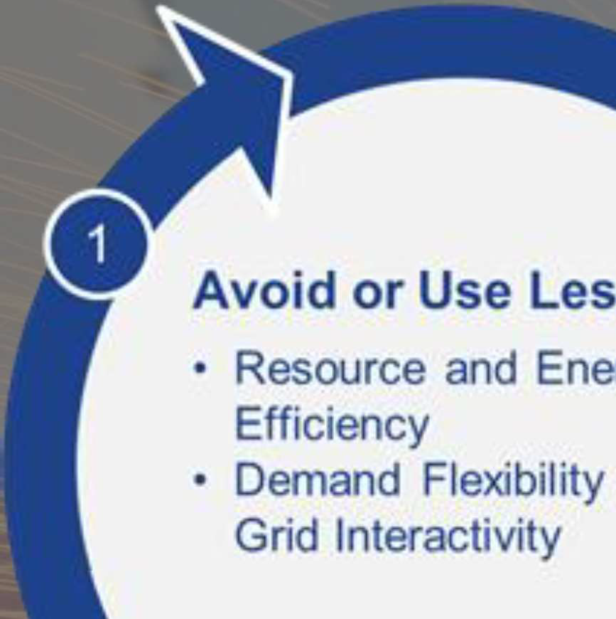
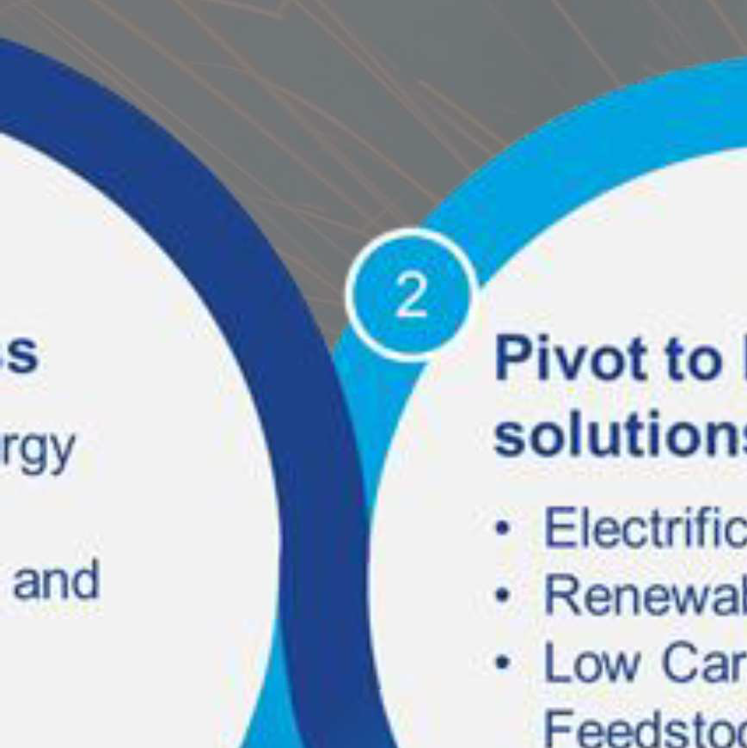
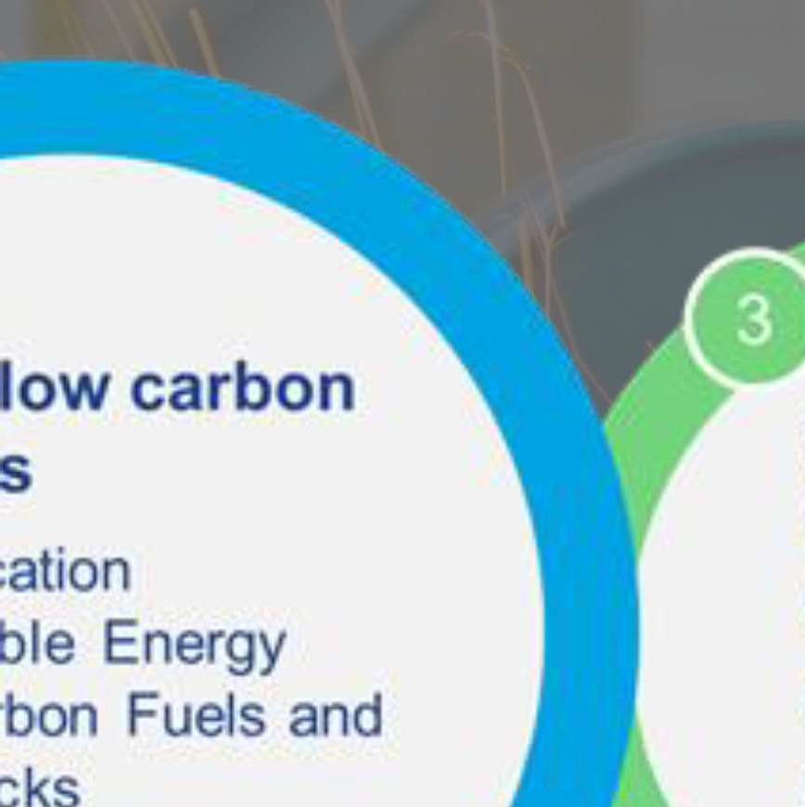
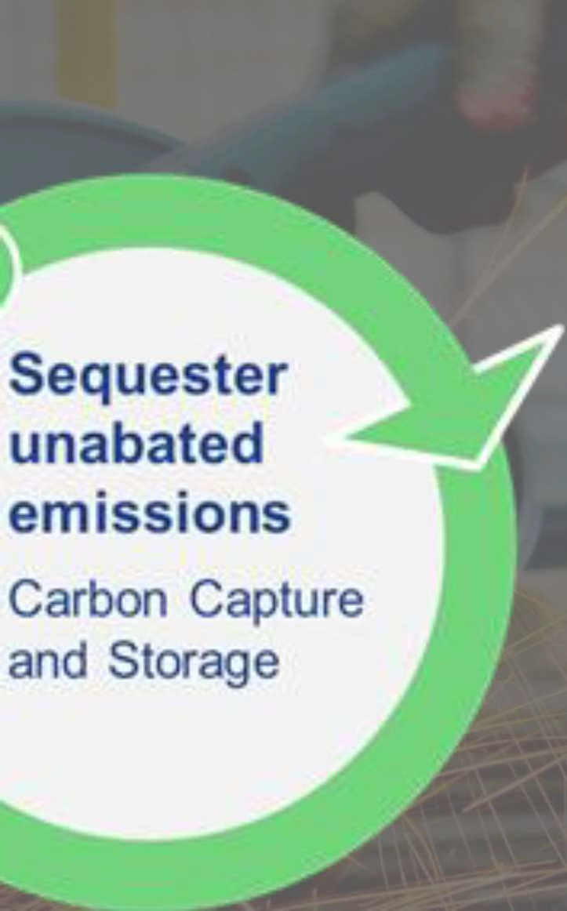







Slide 46
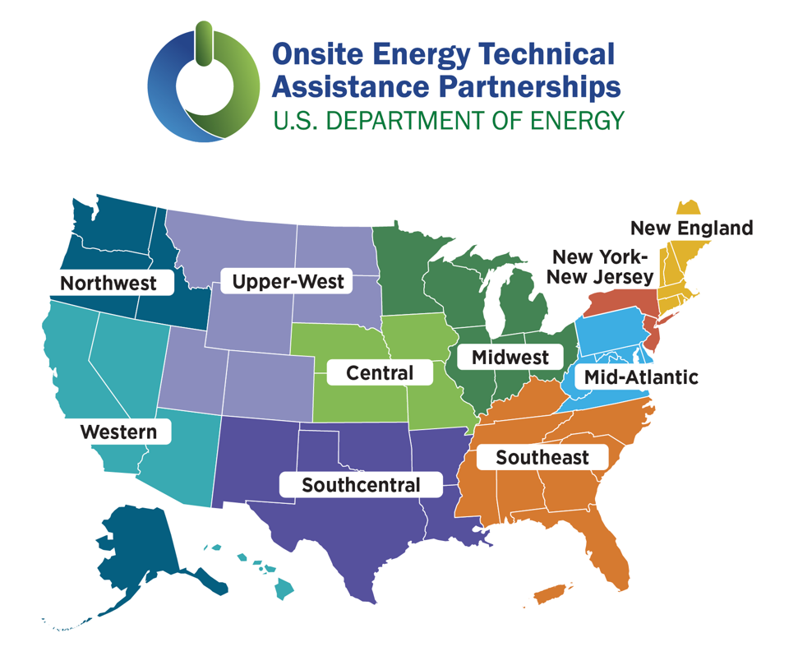
Onsite Energy Technical Assistance Partnerships
(TAPs)
The U.S. Department of Energy created the Onsite Energy Program to help industrial facilities and other large energy users transition to clean energy, lower costs, reduce emissions, and contribute to a clean energy economy.
TAPs evaluate sites for opportunities to implement onsite energy technologies and provide advanced services.
Industrial Assessment Center Implementation Grant Program - small and medium-sized manufacturers may receive grants of up to $300,000 to implement projects identified in screenings conducted by the Onsite Energy TAPs.
https://betterbuildingssolutioncenter.energy.gov/onsite-energy/taps

Slide 47



Onsite Energy Technical Assistance Partnerships (TAPs)
Key services include:
Technical Assistance: Screen sites for opportunities to implement onsite energy technologies and provide advanced services to maximize economic impact and reduce risk from initial screening to installation to operation and maintenance.
Stakeholder Engagement: Engage with strategic stakeholders, including utilities and policymakers, to identify and reduce barriers to onsite energy through fact-based, unbiased education.
End-User Engagement: Partner with organizations representing industrial and other large energy users to advance onsite energy as a cost-effective way to transition to a clean energy economy.

Slide 48
603-862-3171 / C: 603-502-3670
ROBERT.SULLIVAN@UNH.EDU
MATT.DAVIS @UNH.EDU
SWATSON@WATSONSTRATEGY.COM

Slide 49
Commercial and Industrial
Custom Incentive Programs
Efficiency Maine – Jesse Remillard

Slide 50


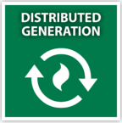
Compressed air systems
High efficiency HVAC systems and controls
Variable frequency drives (VFDs)
Pumps, blowers, motors
New chillers
Refrigeration upgrades
Beneficial electrification
Heat recovery
Process equipment upgrades
HVAC controls and optimization
Condensate recovery
Mechanical insulation
Reciprocating engines
Steam turbines
Notes:
The 3 distinct tracks within the C&I Custom program (based on project type).
The first is Electric Projects, which are those that reduce the consumption of grid-supplied electricity. This includes things like compressed air systems and components, heat recovery, variable frequency drives (VFDs), HVAC controls and optimization, chillers, and refrigeration upgrades.
Thermal Projects – are those that reduce the consumption of natural gas, oil, biomass and other fuels. Project elements might include pipe insulation, heat recovery, condensate recovery, process steam reduction; HVAC controls and optimization; heat exchangers, and recovery boilers.
Distributed Generation – captures behind-the-meter generation projects that reduce the consumption of grid-supplied electricity. Qualifying examples include reciprocating engines, Steam Turbines, Anaerobic digesters, and Organic Rankine cycle processes. Please note that project incentives will not cover electricity export to the grid or other customers.

Slide 51
Electric, or Distributed Generation Incentives
Limitation | Retrofit | New Construction or Equipment at End of Life
Base Incentive Rate | Electric: $0.30 per kWh saved annually DG: $0.28 per kWh saved annually
Standard EMT Cost Share | 50% of net cost | 75% of net incremental cost
Fiscal Year Limit | $1,000,000
Simple Payback | 1 year based on net project cost | 1 year based on net incremental cost
Incentive
capped at the lesser of:

Slide 52
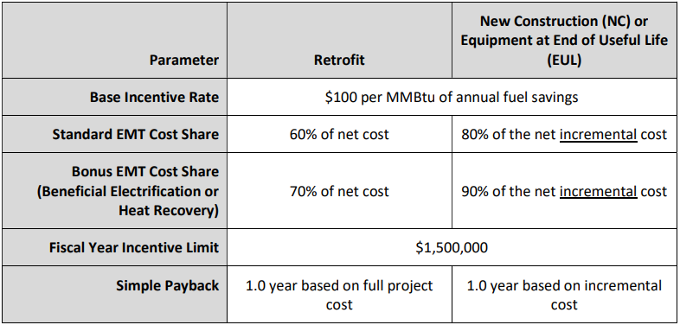
Manufacturer Fuel Savings Incentives
Compares to $25 per MMBtu in standard Thermal Program
Incentive
capped at the lesser of:
Notes:
In order to participate in the program, a customer’s project must also qualify for an incentive of at least $10k
So, how do we determine those incentives? We assess the project against a number of incentive guardrails, and set the award at the *lesser value of those calculations.
So, let’s go through the list.
1. We start by setting the incentive at a % of project cost
50% of project cost for retrofit projects and 75% for lost opportunity projects
To be clear, Retrofit projects involve the replacement of functional equipment before the end of its useful life
While “lost opportunity” either refers to projects in entirely new facilities or projects that involve the replacement of equipment at the end of its useful life
For lost opportunity, the project cost is defined as the incremental cost between the efficient piece of equipment and the standard baseline equivalent
2. We then make sure the incentive does not exceed the annual per participant cap for each program track, which is $1,000,000 for electric/dG and $500k for Thermal. I say “annual” because a participant may apply up to three years of their annual cap to one project provided it meets all other program criteria. For example, an awarded project may be eligible for $3,000,000, but that incentive would be paid out in three, $1,000,000 installments over three successive fiscal years
3. Next, we make sure the incentive does not exceed the “per-unit-of-energy” caps – 28 cents of incentive dollars /kWh saved or 25 incentive dollars /MMBtu saved
4. Finally, we cannot provide an incentive that buys the project down below a 1-year payback, so we calculate that threshold value and assess it against the other guardrails.

Slide 53
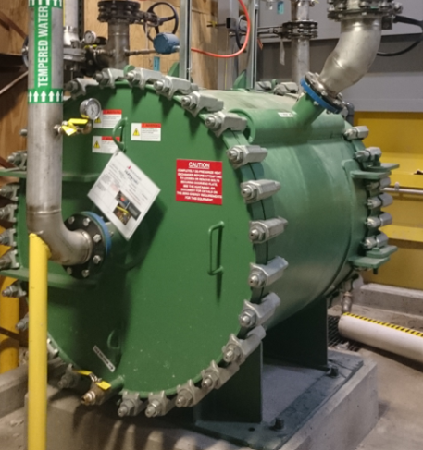
Heat Recovery From Process Heat
Project included installation of multiple heat exchangers to recover heat from electrically driven drying process.
Thermal Program: Retrofit
Project cost: $1.3M
  Incentive: $650k
Annual energy savings
  4,500,000 kWh/year electric
Return on investment
  Less than 4 years after incentive
Would now qualify for elevated
Manufacturer incentives

Slide 54
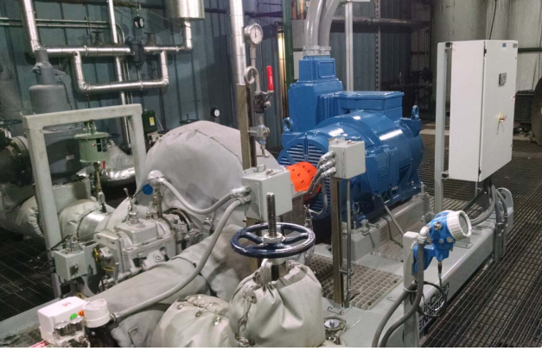
Back-Pressure Steam Turbine Generator
Combined heat and power is a great solution for facilities with continuous thermal loads and produces the best return on investment when there is access to low-cost fuels (NG or biomass).
Distributed Generation Program: retrofit
Project cost: $1.3M
  Incentive: $625k
Annual energy savings
  2,200,000 kWh/year electric
Return on investment
  Less than 4 years after incentive
CHP now eligible for 30% Investment Tax Credit (ITC)

Slide 55
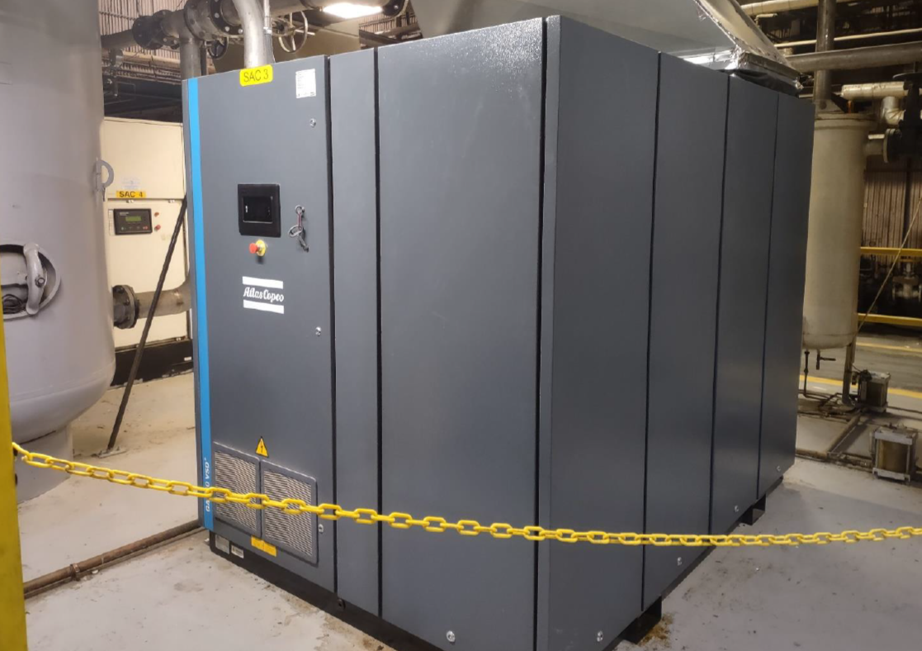
High Efficiency Compressed Air Systems
Project included high efficiency compressors, dryers, controls and piping improvements to allow reduction of operating pressures.
Electric Program: end of life replacement
Additional cost for high efficiency system: $300k
  Incentive: $180k
Annual energy savings
  700,000 kWh/year electric
Return on investment
  Less than 2 years after incentive

Slide 56
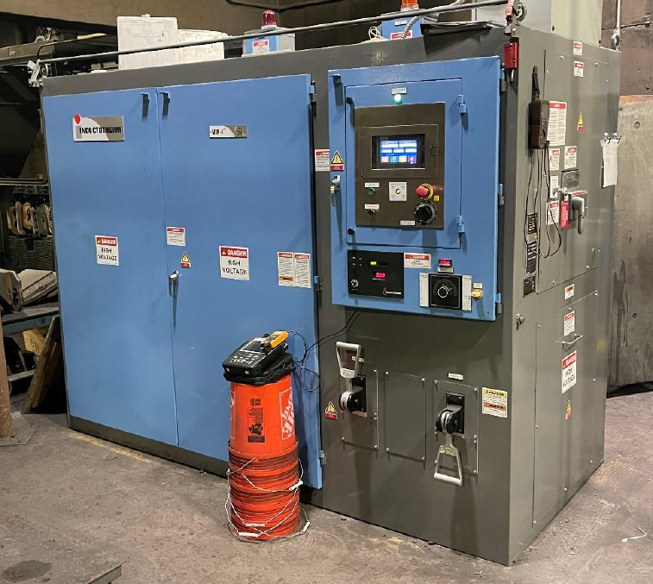
High Efficiency Power Supply for Induction Furnace
Reduces losses associated with power supply for electric induction furnaces.
Electric Program: end of life replacement
Additional cost for high efficiency unit: $45k
  Incentive: $33k
Annual energy savings
  167,000 kWh/year electric
Return on investment
  Close to 1 year after incentive

Slide 57
Efficiency Maine Projects at Texas Instruments – MFAB
24 May 2024

Slide 58
Execute Aggressive Installation Schedules
Project Description: Replace and retrofit the existing lighting on the Texas Instruments Maine campus with new LED lighting fixtures.
Assistance from Efficiency Maine allowed for:
  Have multiple portions of the overall project happen concurrently.
  Bring additional lighting areas within the Texas Instruments ROI timeframe, allowing more lights to be converted and installed.
Within 3 years, 80% of all lighting on the Texas Instruments Maine campus has been converted to LED.

Slide 59
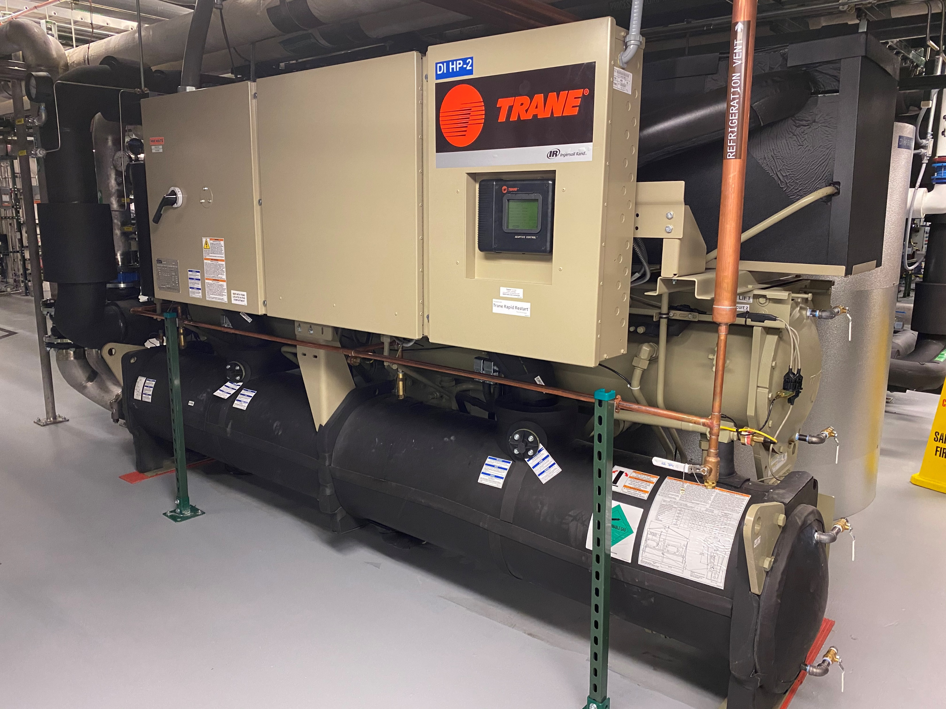
Justify Large Energy Conservation Equipment
Project Description: Install new high efficiency energy recovery pumps and energy valves. This reduced the load on both the chilled water plant and the steam plant by taking excess heat from a closed cooling water loop and transferring heat to incoming city water and hot water systems.
Incentives from Efficiency Maine brought down installation costs for new equipment
  The project met with a 50% project incentive
  Equipment then met the Texas Instruments ROI timeframe

Slide 60
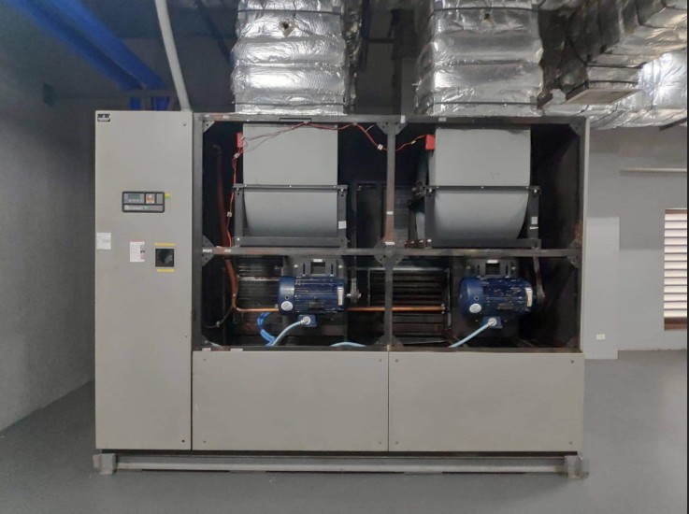
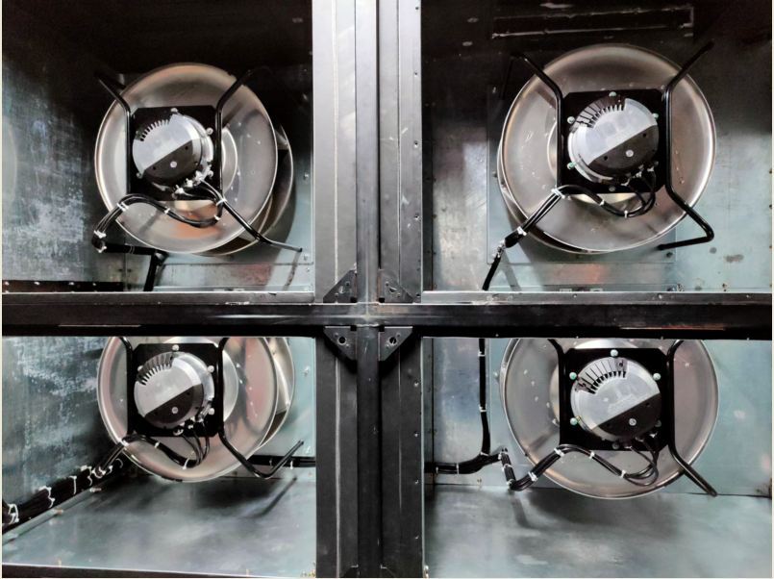
Implement Emerging Technologies
Project Description: Retrofit existing
building supply air fans with new EC
fan walls.
A custom project that is currently
working with Efficiency Maine to
keep the ROI competitive for installations.
Reduces energy through controls and
higher efficiency systems.
Reducing energy by 40%-70% for both VFD
and non-VFD systems. EC Fan walls have
the ability to have internal redundancy,
reducing the need for additional supply air units.

Slide 61
Panel Dialogue
Moderator: Bill Whittier – Maine MEP, Kyle Rooney – UMaine AMC

Slide 62
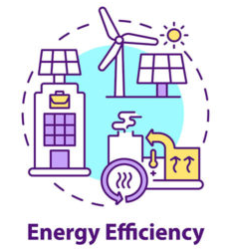
Panelists
Mike Cloutier – Constellation
Sabin Rossi – Constellation Energy Solutions
Jesse Remillard – Efficiency Maine
Mike Belanger – Texas Instruments
Robert Sullivan – US DOE (UNH)

Slide 63
MAME Annual Awards
Pine Tree Award (MWPA) and Manufacturer of the Year (MAME)

Slide 64


Pine Tree Award
TimberHP – Madison, ME

Slide 65


Manufacturer of the Year
DeepWater Buoyancy – Biddeford, ME

Slide 66

The last word. . .
MAME Golf outing for the Scholarship foundation
  September 19, 2024 – Spring Meadows Golf Club (Gray)
MAME Annual meeting (GALA)
  October 25, 2024 – CMCC, Auburn, ME
Maine Space Conference
  October 23-25, 2024 – Holiday Inn By the Bay (Portland)

Slide 67

LUNCH is available in the lobby. . . Please help yourself!!

Slide 68

SAFE
travels
home

